Slide 1
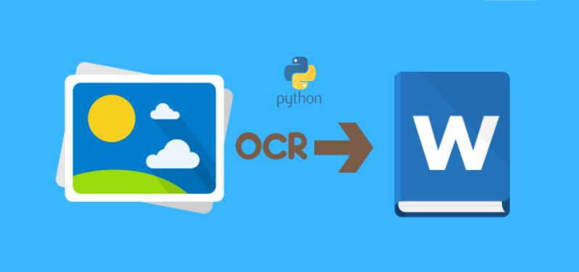
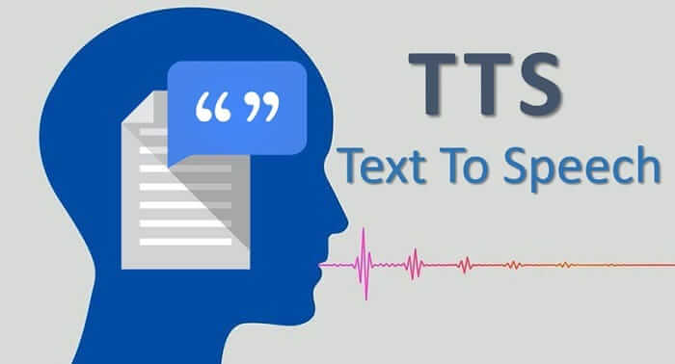
Text recognition Based on Image Processing & Machine Learning

Slide 2
Objective
To recognise text from image using machine learning and image processing.
Converting recognised text to speech.

Slide 3
Any Typical machine learning OCR pipeline follows the following steps :
Image Preprocessing
Text Detection
Text Recognition

Slide 4
Image Preprocessing
The aim of pre-processing is an improvement of the image data that suppresses unwilling distortions or enhances some image features important for further processing.
The standard ways to preprocess image in a computer vision task:
Remove the noise from the image
Remove the complex background from the image
Handle the different lightning condition in the image

Slide 5
Text Detection
Text detection techniques required to detect the text in the image and create bounding box around the portion of the image having text. Standard objection detection techniques will also work here.
The technique used for text detection:
Sliding window technique.
Single Shot and Region based detectors.
EAST (Efficient accurate scene text detector)

Slide 6
Text Recognition
Once we have detected the bounding boxes having the text, the next step is to recognize text. There are several techniques for recognizing the text.
The best technique used for text recognition:
CRNN:
Convolutional Recurrent Neural Network (CRNN) is a combination of CNN, RNN, and CTC(Connectionist Temporal Classification).

Slide 7
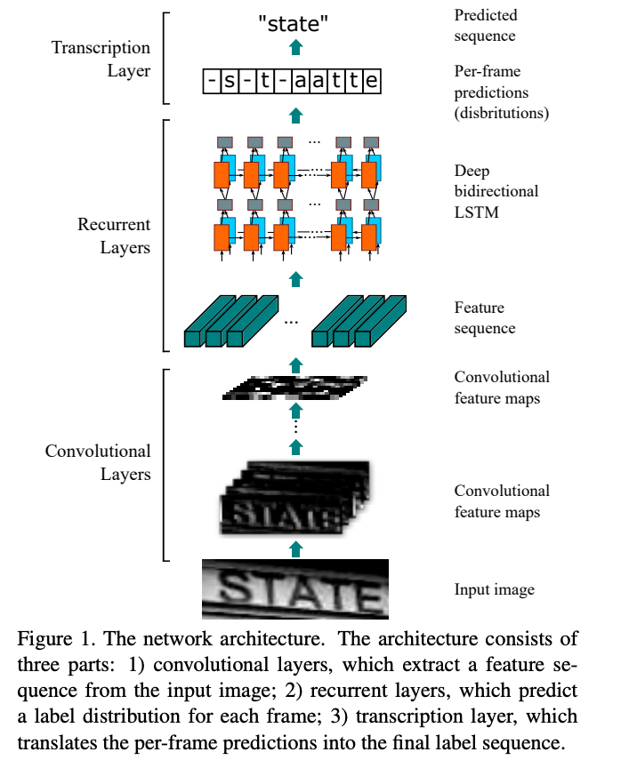
The network architecture.

Slide 8
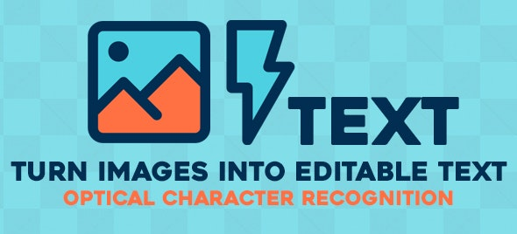
Optical Character Recognition (OCR)
OCR stands for Optical Character Recognition. It is a widespread technology to recognise text inside images, such as scanned documents and photos. OCR technology is used to convert virtually any kind of images containing written text (typed, handwritten or printed) into machine-readable text data.

Slide 9
Machine Learning OCR with Tesseract
Tesseract was originally developed at Hewlett-Packard Laboratories between 1985 and 1994. In 2005, it was open-sourced by HP. As per wikipedia-
In 2006, Tesseract was considered one of the most accurate open-source OCR engines then available.
The capability of the Tesseract was mostly limited to structured text data. It would perform quite poorly in unstructured text with significant noise. Further development in tesseract has been sponsored by Google since 2006.

Slide 10
Tesseract 4.0
Tesseract 4.0 with LSTM:
Deep-learning based method performs better for the unstructured data. Tesseract 4 added deep-learning based capability with LSTM network based OCR engine which is focused on the line recognition but also supports the legacy Tesseract OCR engine of Tesseract 3 which works by recognizing character patterns.
LSTM:
Long short-term memory (LSTM) is an artificial recurrent neural network (RNN) architecture used in the field of deep learning. It can not only process single data points (such as images), but also entire sequences of data (such as speech or video).

Slide 11
Text-to-Speech (TTS)
A text-to-speech (TTS) system converts normal language text into speech
Different types of TTS in Python:
Pyttsx text to speech:
Pytsx is a cross-platform text-to-speech wrapper.It uses different speech engines based on your operating system
2. gTTS text to speech
gTTS is a module and command line utility to save spoken text to mp3. It uses the Google Text to Speech (TTS) API.
3. Microsoft speech engine
If you use Microsoft Windows 10, it has a speech engine included. Install the module win32com.

Slide 12
Thank You

